Slide 1

Exploratory Data Analysis
Healthcare – Persistency of a Drug
21st Oct, 2023

Slide 2
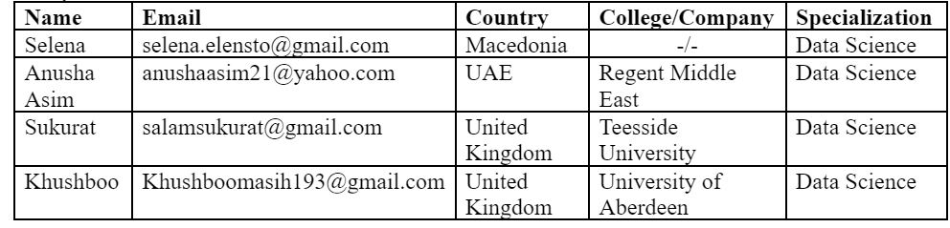
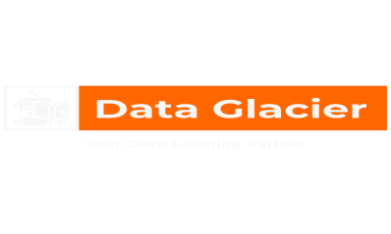
Internship Batch: LISUM24 Group: HealthData Collective Group Members:
GitHub Repo: https://github.com/venusflytrapfairy/HealthDataCollective-Group

Slide 3
Agenda
Background
Problem Statement
EDA
Final Recommendations for Technical Users

Slide 4
Background – Pharmaceutical Industry
Pharmaceutical Industry Landscape: The pharmaceutical industry is a key player in global healthcare, dedicated to developing and delivering life-saving medications. Understanding patient medication persistency is pivotal for improving patient outcomes, informing marketing strategies, and ensuring the success of drug therapies.
HealthData Collective: The HealthData Collective is a group of international data science interns from diverse backgrounds. Our mission is to utilize data-driven insights to address pharmaceutical challenges and enhance patient care.
Project Objective: Our project focuses on automating the identification of patient medication persistency based on physician prescriptions. By leveraging machine learning, we aim to provide pharmaceutical companies with the tools to better understand and improve patient treatment adherence.
Key Stakeholders: The project serves the interests of pharmaceutical companies, healthcare providers, and most importantly, patients. Accurate insights into medication persistency can lead to better-informed decisions, ultimately improving healthcare outcomes.

Slide 5
Problem Statement & Business Implications
The problem to be solved is related to pharmaceutical companies' need to understand the persistence of drug usage among patients based on physician prescriptions. Specifically, the challenge is to automate the process of identifying whether a patient is persistent in following their prescribed therapy regimen. The primary problem is to build a classification model using machine learning to determine the persistence of patients based on various features and factors.
Business Implications:
Enhanced Patient Outcomes: Improving medication persistency directly contributes to better patient health outcomes. Pharmaceutical companies benefit from positive patient experiences and the potential for increased usage of their products.
Marketing Strategy Optimization: Accurate insights into medication persistency enable pharmaceutical companies to tailor marketing strategies. This leads to more targeted campaigns, ensuring that the right patients receive the right messages, thus optimizing marketing investments.
Treatment Efficacy Assessment: By automating the process of identifying medication persistency, pharmaceutical companies can evaluate the efficacy of their drugs in real-world settings. This data is invaluable for refining existing medications and developing new ones.
Cost Savings: Patients who adhere to their prescribed therapy regimens often require fewer medical interventions and hospitalizations. This leads to cost savings for both patients and healthcare systems, making medications more cost-effective in the long run.
Compliance Reporting: In many healthcare systems, pharmaceutical companies are required to provide compliance reports. Accurate medication persistency data simplifies compliance reporting and ensures companies meet regulatory requirements.
Improved Revenue: Patient persistency is directly linked to product revenue. Increased persistency can lead to higher product sales and revenue, while low persistency may necessitate product improvements or lifecycle management strategies.
Long-term Customer Loyalty: Improving medication persistency fosters patient loyalty. Patients who experience successful outcomes with a particular medication are more likely to remain loyal to the brand and continue using it for their healthcare needs.

Slide 6
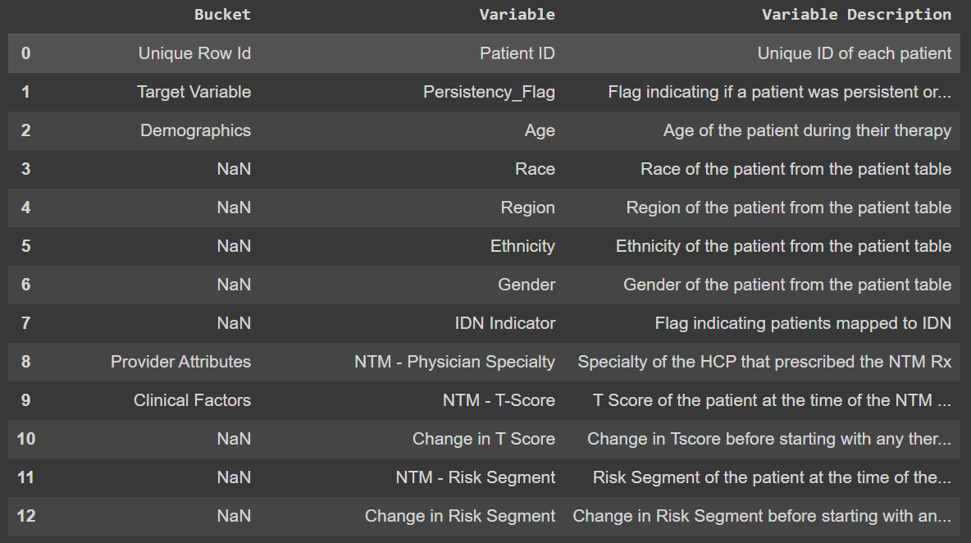
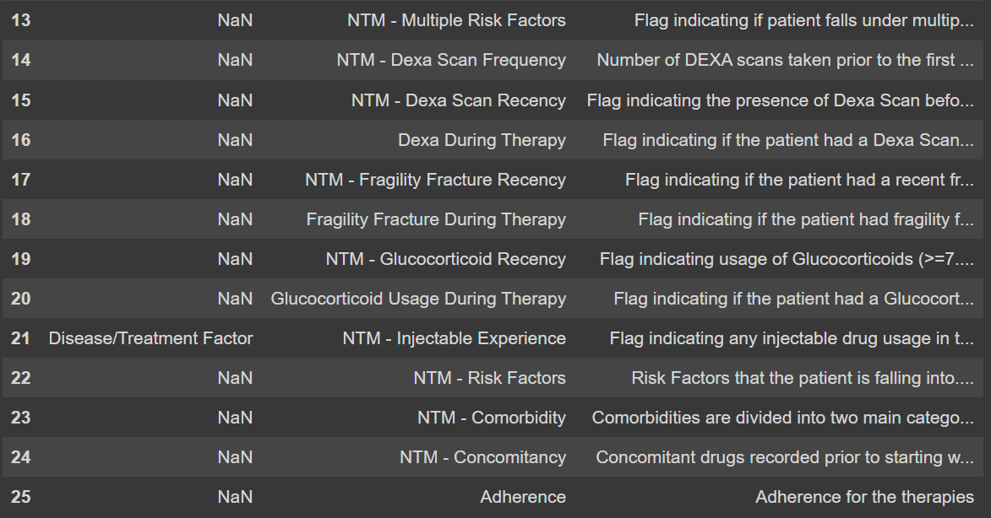
Data Exploration
26 features
Target feature: Persistency_Flag
3424 rows × 69 columns

Slide 7
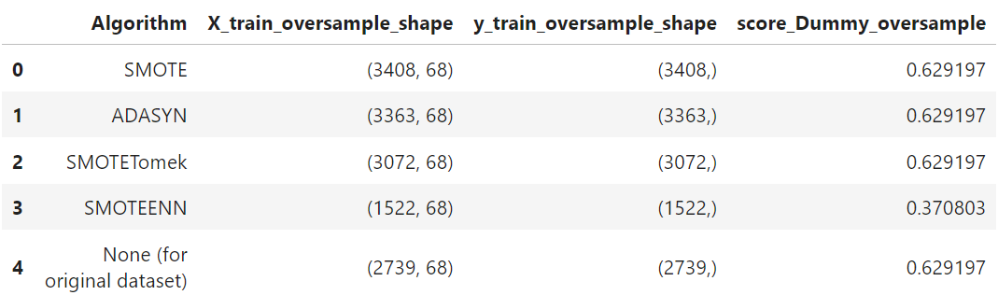
Exploratory Data Analysis (EDA)
A summary of the tasks performed on the dataset:
Data Loading: Loading the dataset from Excel file on pandas
Data Profiling: Explanations for each future
Data Cleaning: Identifying and handling “unknown” values
Dedpulication: Handling duplicate records
Data Visualization: Generating profile report, histograms and other graphs
Label-Encoding: Dealing with non-numerical features
Model Development: Basic Linear Regression model
Oversampling: Applying oversampling techniques to deal with imbalanced classes
Comparison with Original Dataset: We’ve included a row in the summary to compare results with the original dataset without oversampling.

Slide 8
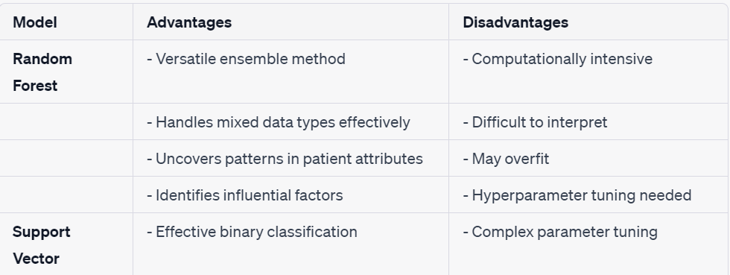
Final Recommendations
Recommended Models and Their Advantages/Disadvantages:

Slide 9
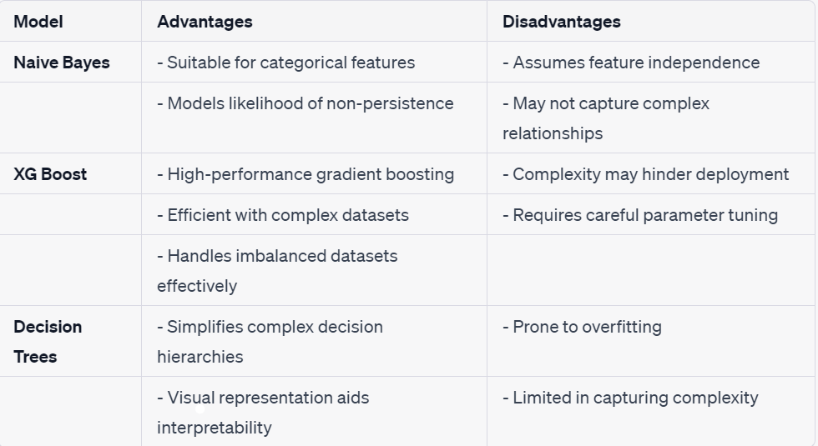
Final Recommendations
Recommended Models and Their Advantages/Disadvantages:

Slide 10
Thank You

